Slide 1
Partizzle
MERN Stack

Slide 2

Team
AMANDEEP SINGH (Leader)
RITIK BHATNAGAR

Slide 3
Objective
The objective of Partizzle is to provide party related items like cake, beverages, theme packages, cakes and decoration material all at same place.

Slide 4

Technology Used
HTML
CSS
VANILLA JAVASCRIPT
BOOTSTRAP
REACT JS
NODE JS
MONGOBD

Slide 5

Minimum Requirements
SCREEN SIZE ABOVE 250PX WIDTH
ANY OPERATING SYSTEM
ANY DEVICE WITH WEB BROWSER (CHROME RECOMMENDED)
INTERNET CONNECTION

Slide 6
Modules
Home
Login
Signup
Drinks
Food
Decoration
Theme
Cart

Slide 7
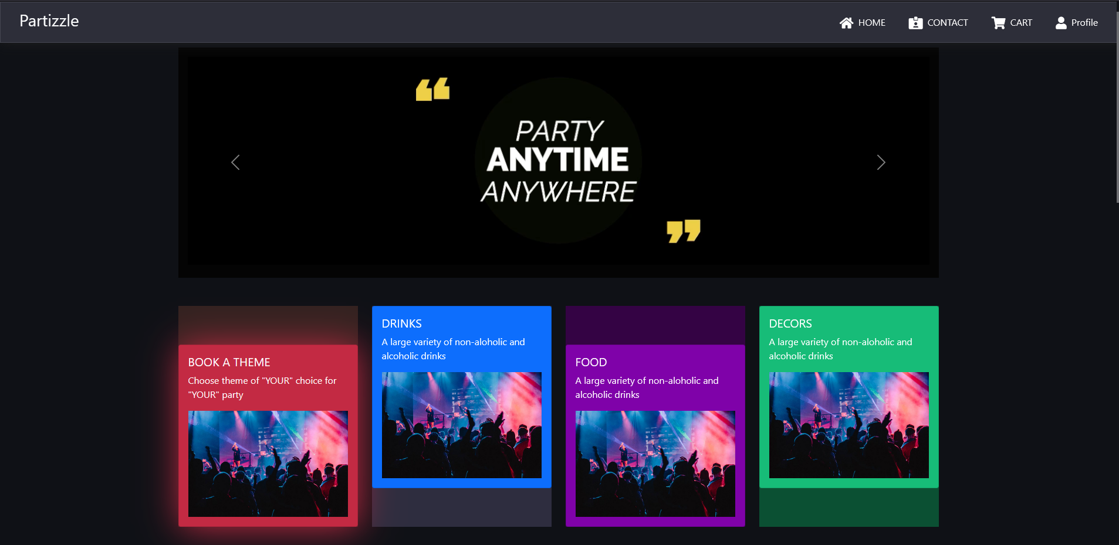
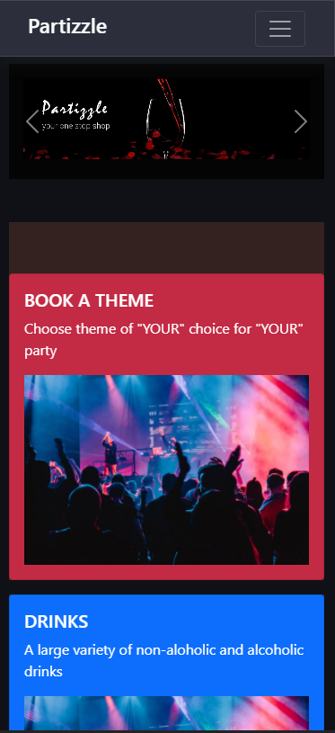
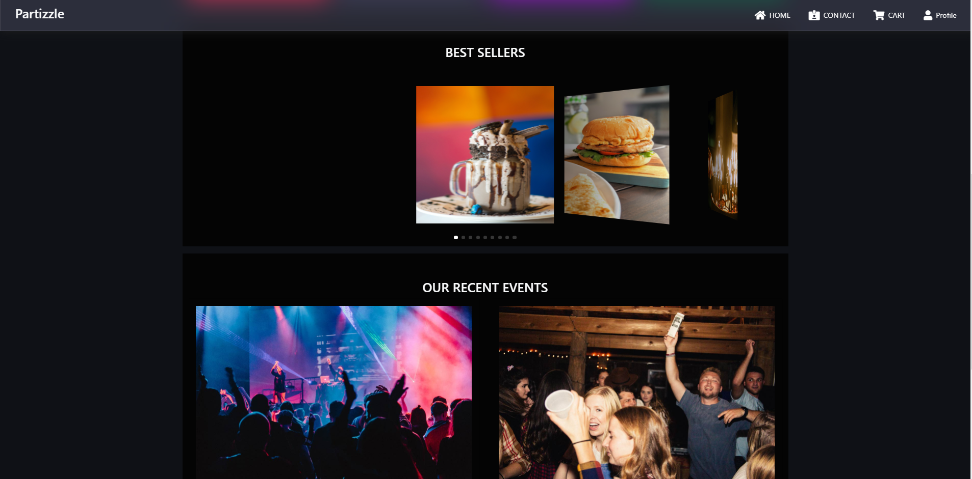
Screenshots

Slide 8
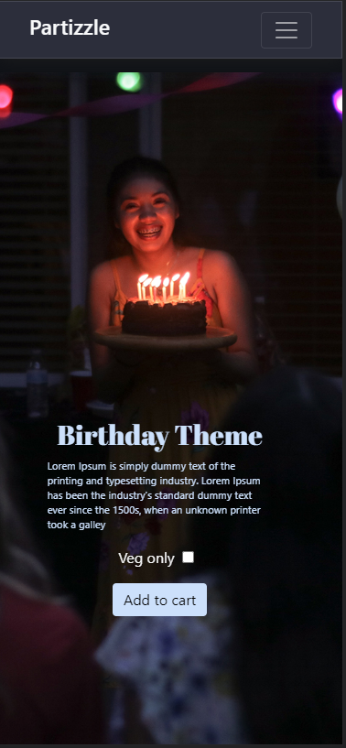
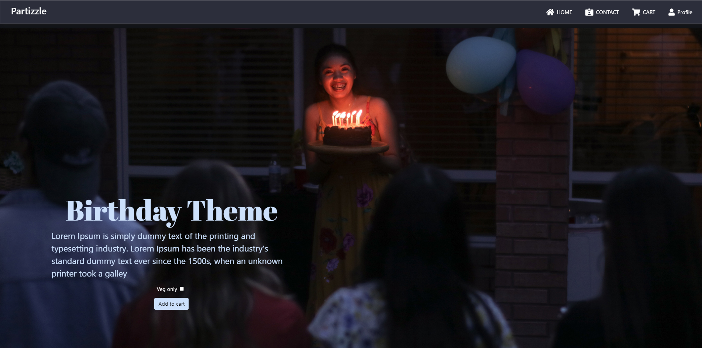
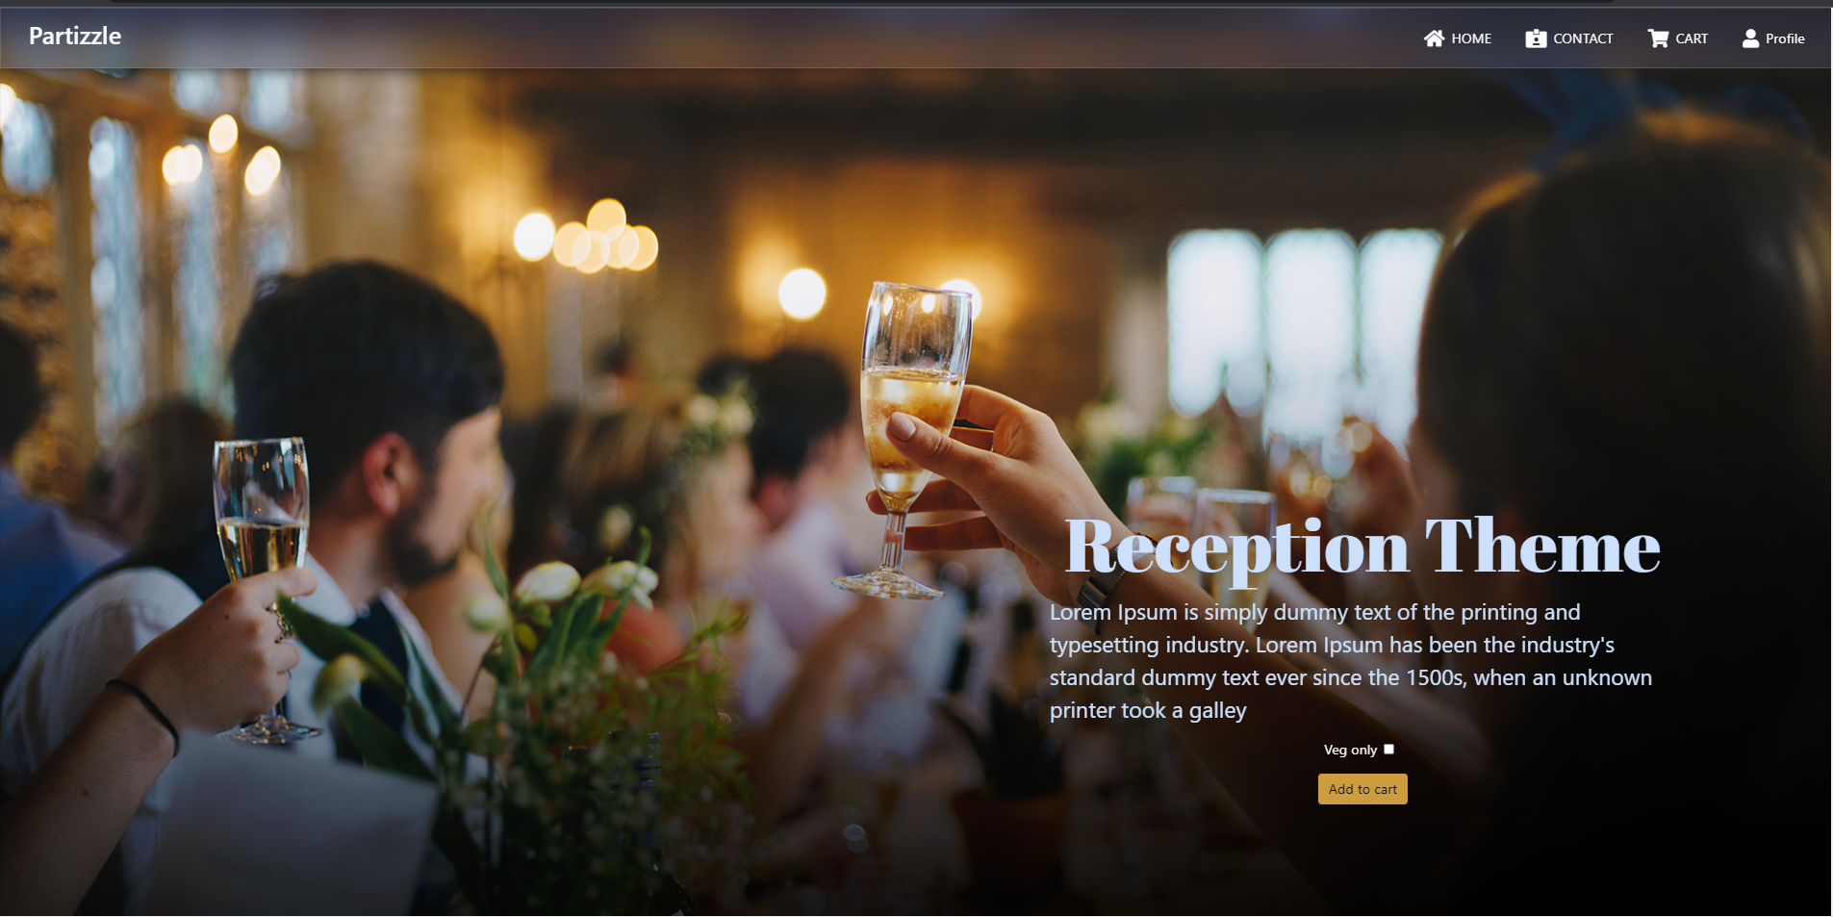

Slide 9
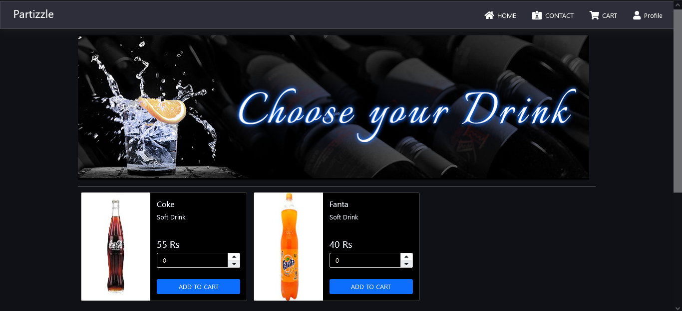
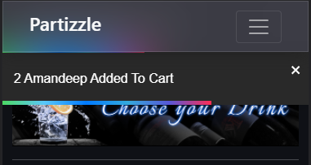
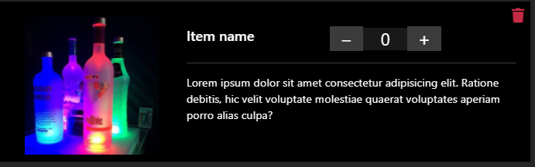

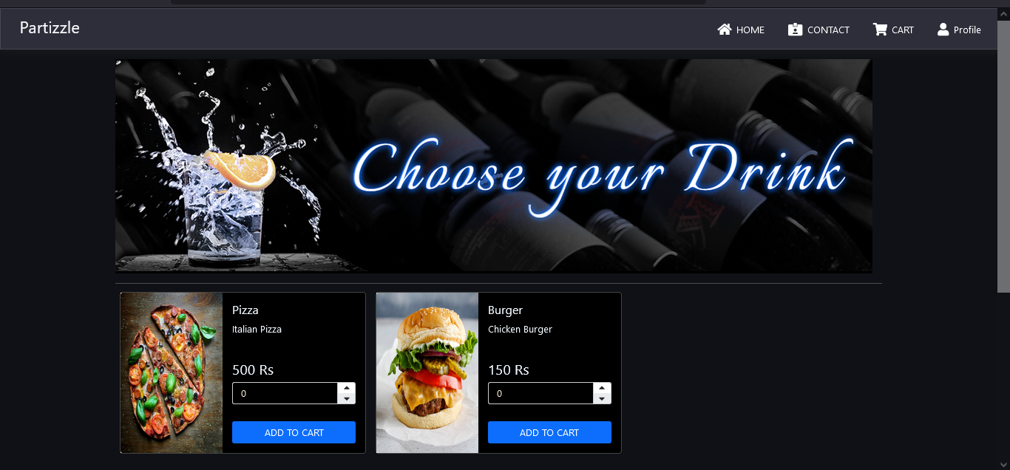
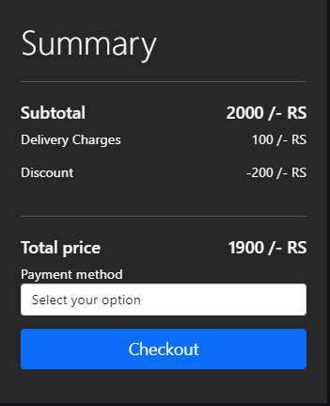

Slide 10
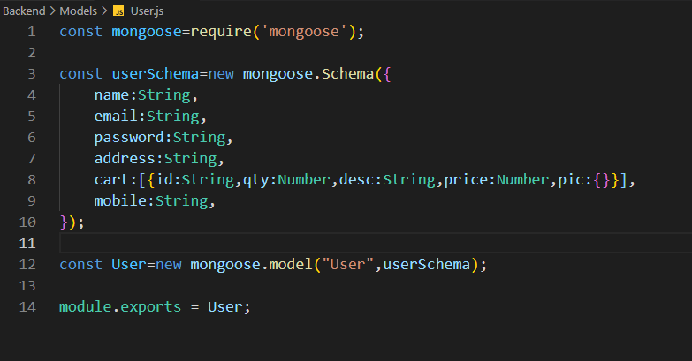
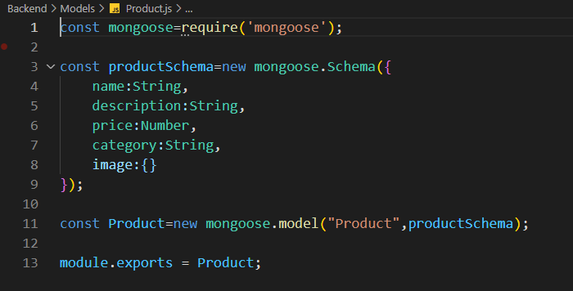
SCHEMA

Slide 11
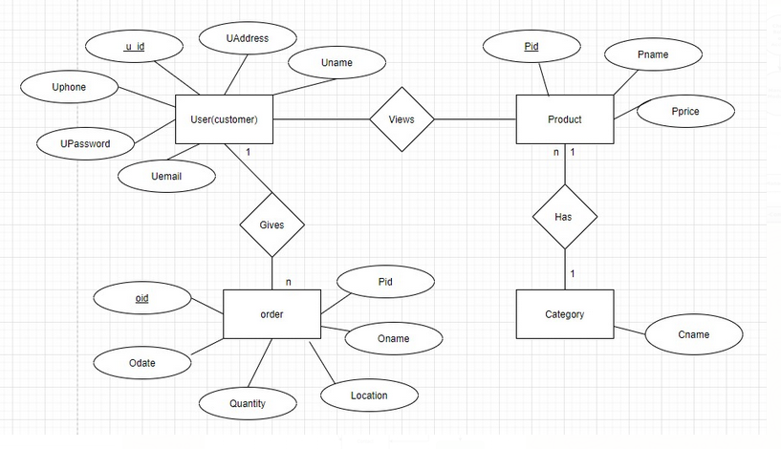
ER-Diagram

Slide 12
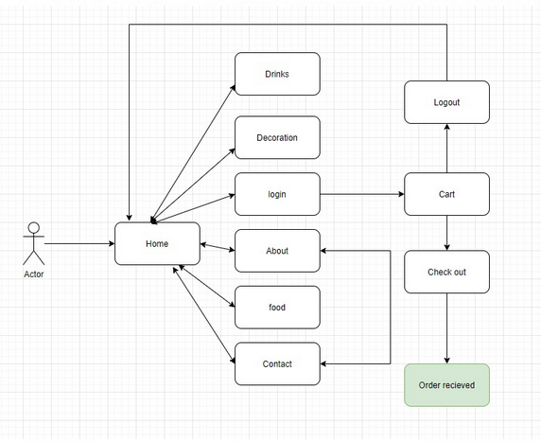
DFD

Slide 13
THANK YOU

